Slide 1

GAME ON: Unveiling the future of Women’s Basketball ticket sales with predictive analytics
Team Data Jedi
Akanksha Singh
Aravind Teja Chikoti Harshraj Jadeja Santosh Pawan Kurada
Sathwik Kanukuntla

Slide 2

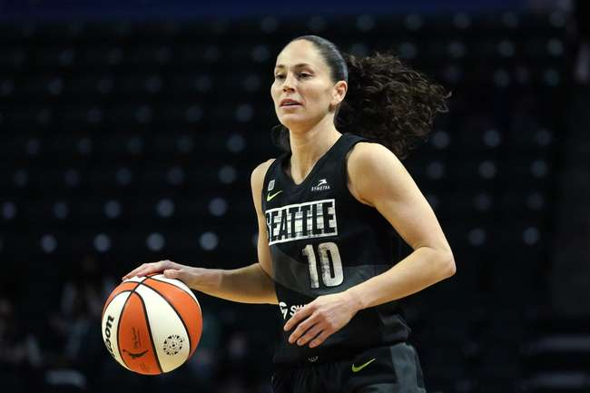
"I think the beauty of women's basketball is seeing the passion, the teamwork, the camaraderie, and the pure joy of playing the game. It's not just about the sport; it's about lifting each other up and proving every day that we belong on this court just as much as anyone else."
Sue Bird
(WNBA Player)
01

Slide 3


100
The viewership for the Women's NCAA Basketball Tournament has seen an increase, with the championship game's viewership rising by over 30% in recent years
90
30%
80
70
60
50
40
The number of women participating in NCAA basketball has grown by approximately 25% since the early 2000s
30
25%
20
10
0
The Women's NCAA Tournament has seen a surge in its economic impact, with host cities reporting over $20 million in revenue from the event, underscoring the significant financial contribution of women's basketball to local economies.
Approximately 6% of NCAA Division I women's basketball players go on to compete professionally, either in the WNBA or overseas
6%
02

Slide 4

The ‘ why ’ of prediction
Develop predictive models using Division I Women’s Basketball customer data, supplemented with external datasets, to accurately forecast whether a customer will purchase a ticket and through which market (primary or secondary).
Activity Types:
No Activity
Primary Purchase
Secondary Purchase
Other Secondary Activity
Multiple Activities
Transfer Recipient
Stakeholders
NCAA
Increased Revenue
Customer Insights
Operational Efficiency
For Customers:
Improved Experience
Accessibility to tickets
For Sponsors & Partners
Brand Exposure
Data-Driven Partnerships
Objective
Target
03

Slide 5


SOLUTION APPROACH
Data Preprocessing
Recommendations
Cleanse and prepare the data for modeling by handling missing values, encoding categorical variables, and normalizing the data
Based on model outcomes, suggest targeted strategies to maximize ticket sales through the appropriate markets.
Exploratory Data Analysis
Future Scope & Learning
Model Building
Scrutinize the customer data, along with external datasets, to understand patterns and trends
Construct and train predictive models using machine learning algorithms to forecast customer behavior
Reflect on the model's performance to identify opportunities for improvement.
04

Slide 6







Dataset information
No. of Rows & Columns
200k Rows & 25 Features
10+
Additional Features
6
Unique Activity Types
Level of data
Record ID
23+
Teams Accounted For
05

Slide 7
Data preprocessing
Layer 1 | Null Imputation & Feature Engineering
Feature Engineering
Null Imputation
Duration for all events, purchases and actions
College Basketball Rankings
Engagement Score (Based on the email engagements of customers)
Temporal attributes
Consumer information by zipcode
Unknown for Categorical Columns (Nulls, ‘Unk’, ’NA’)
Median imputation for Numerical columns
All the features have been scaled using Standard Scaler separately for test and train dataset
06

Slide 8
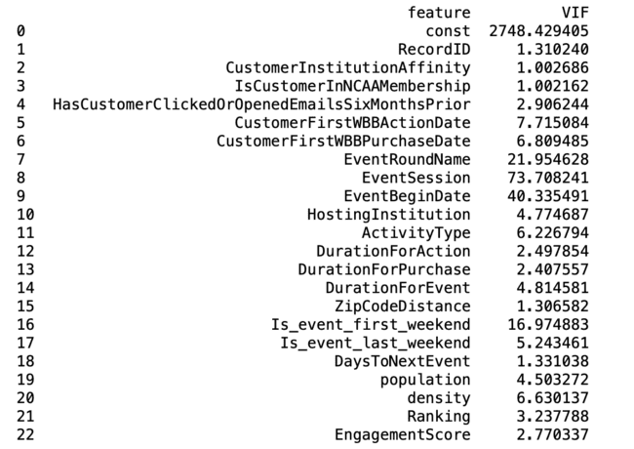
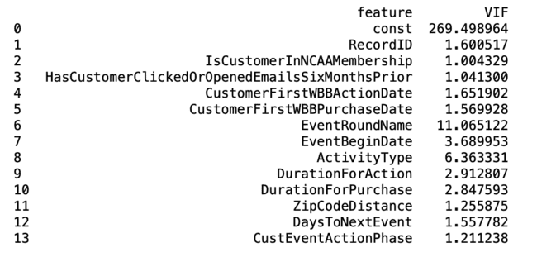
Data preprocessing
Layer 2 | Dropping columns with high multicollinearity
Before
After
The VIF significantly reduced after columns like “CustomerInstitutionAffinity” were dropped
07

Slide 9


PREDICTIVE MODELING
Model 1 – Stacking Classifier
Validation Accuracy: 99.100 %
Public leaderboard Accuracy: 98.575 %
Precision: 71.031 %
Recall: 69.673 %
XGBoost
(base learner)
Estimators – 100
Learning Rate – 0.1
Max Depth – 6
Eval Metric – log loss
Random Forest
(base learner)
Iterations – 150
Learning Rate – 0.05
Max Depth – 8
Min Sample Split – 2
Min samples leaf - 1
Logistic Regression
(meta learner)
Iterations – 800
C – 1.0
Model 2 - Ensemble (Soft Voting)
CatBoost
Iterations – 500
Learning Rate – 0.05
Depth - 6
XGBoost
Estimators – 100
Learning Rate – 0.1
Max Depth – 6
Eval Metric – log loss
Random Forest
Iterations – 150
Learning Rate – 0.05
Max Depth – 8
Min Sample Split – 2
Min samples leaf - 1
Validation Accuracy: 99.004 %
Public leaderboard Accuracy: 98.508 %
Precision: 70.985 %
Recall: 67.983 %
08

Slide 10





Recommendations | Enhancing Ticket sales
Loyalty & Rewards program
Data Driven Event Management
Use External Data
Introduce loyalty programs that reward customers for purchasing through the primary market
Use predictive insights to better plan event logistics, including venue selection & staffing levels
Include economic trends, social media sentiment analysis, etc. to improve model performance
Feedback Loops
Enhance Customer Service
Implement mechanisms to capture customer feedback post event to refine the model
Understanding customer's likelihood to purchase can help representatives provide tailored assistance
09

Slide 11
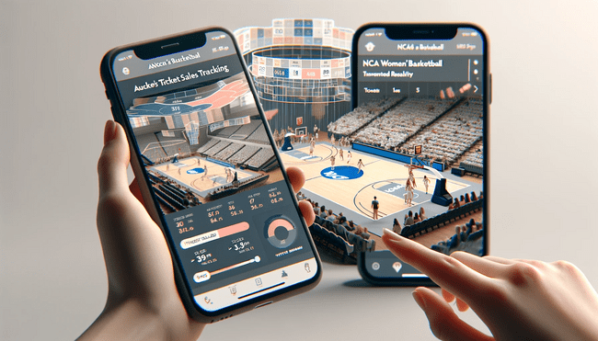
Future scope | app-based tracker
Benefits to NCAA
Real-time sales tracking
Fan-Insights
Goal-Setting & Tracking
Community Building
Optimize Pricing & Promotions
Real-Time Feedback
Enhanced User Experience
10

Slide 12


To a future of woman basketball dominance
THANK YOU!

